Slide 1

Kyōdō Protocol
The future of Work Powered by Communities
The future of work is being transformed by the relationship between professionals, communities and businesses enabled by new protocols like Kyodo Protocol. Kyodo Protocol facilitates trusted connections between individuals and organizations by leveraging verifiable credentials.

Slide 2



Existing Problem
Difficulty for freelancers and job seekers validating work history
Companies struggle confirming candidate skills
Challenging matchmaking between companies and professionals
Verification processes are time-consuming, error-prone, and invasive of privacy
Traditional resumes expose personal details and have potential for embellishment
Ideal candidates often not on company's radar, leading to delays in hiring
The Kyōdō Protocol provides a secure and private verification system to bridge the gap between companies and professionals

Slide 3

The Kyōdō Protocol streamlines interactions between professionals, communities, and businesses through blockchain tools and zero-knowledge proofs

Slide 4






How it works?
1
Community leaders adopt the protocol and set fees
2
Members register and record contracts
3
Members issue invoices for services
4
Protocol allocates payment and records skills
5
Protocol issues community tokens and badge NFTs
6
Community offers benefits like training to members

Slide 5



Benefits
For Communities
For Professionals
For Contractors
A Sustainable Business Model: Recurring revenue through facilitating hiring of community members
Proof of resume, community benefits and ownership
Proof of hiring, community benefits and, a tool for efficient hiring and management
The Kyōdō Protocol provides benefits for communities, professionals, and contractors through an efficient hiring process while preserving privacy.

Slide 6



Applications of Zero Knowledge Proofs on Kyōdō Protocol
Identity Verification
Transaction Validation
Proof of Resume
ZKP allows members to prove their identity without revealing personal details.
ZKP validates transactions on the protocol without exposing actual data.
Professionals can prove their skills without revealing specific projects or clients.
ZKP enables privacy, security and efficiency on the Kyodo Protocol.

Slide 7
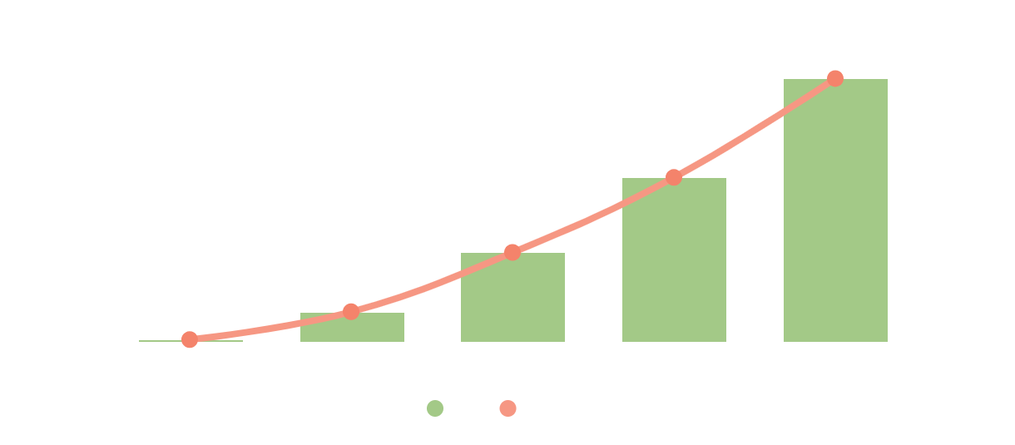
Business Projection

Slide 8
Network Effect
Community Leaders
Professionals
Hiring Boutiques
Professionals can refer their friends and fellows to join the protocol.
Hiring boutique companies are rewarded for referring customers.
Community leaders can bring more professionals into the network.
Reward System
Growth Loop
Participants are rewarded for successfully referring new members.
More participants lead to more referrals, fueling network growth.

Slide 9



Team
Daniel Cukier
Yan Luiz
Melk
Founder
Founder
Founder

